Slide 1
Data visualization
All samples available on:
http://github.com/a-vodka/dv

Slide 2
Realisation of the course
This course has been developed within the framework of the project “Mechanics digital" by the German Academic Exchange Service (DAAD) under funding program “Ukraine digital: Ensuring academic success in times of crisis (2022)" The course has been developed in collaboration with our colleagues from the Otto-von-Guericke-University Magdeburg in Germany We would like to thank the DAAD for their financial and logistical support

Slide 3
tensor Visualization
Dr. Jie Zhang, Ronald Peikert materials is used

Slide 4
What is a tensor?
Scalar: ( a )
Vector: V = (v₁, v₂) where v₁ = ∆x, v₁ =∆y
2D Tensor
3D tensor
All are tensors!! Order 0, 1, and 2
(dimension)^{order}
s₁₁ s₁₂
s₂₁ s₂₂
s₁₁ s₁₂ s₁₃ s₂₁ s₂₂ s₂₃ s₃₁ s₃₂ s₃₃

Slide 5
What is a Tensor?
Just a box of numbers!
 | Order | Represented by | Notation
 | Zero | Scalar | c
 | First | 1D array | v_{i}
 | Second | 2D array | A_{ij}
 | Fourth | 4D array | E_{ijkl}
Symmetry: A_{ij} = A_{ji}
E_{ijkl} = E_{jikl} = E_{ijlk} = E_{jilk} = E_{klij}

Slide 6

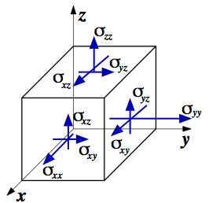
Example: What stress looks like
Diagonal components represent forces along axes (σ₁₁ = X, σ₂₂ = Y, σ₃₃ = Z)
Off-diagonal components represent forces along faces
Shrink the cube down to infinitesimally small
Stress components are symmetric (σ_{ij} = σ_{ji})
σ₁₁ σ₁₂ σ₁₃ σ₂₁ σ₂₂ σ₂₃ σ₃₁ σ₂₃ σ₃₃

Slide 7
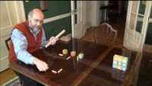
What is tensor? Again!

Slide 8
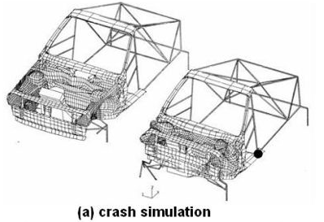
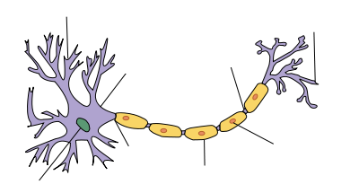
Modeling Physical Phenomena
Fluid Tensor Fields (2D or 3D)
Stress, viscous stress (force from compression)
Momentum flux density
Solid Tensor Fields
Rate of stress, rate of strain, stiffness
Medical MRI: diffusion of water through nerve axons
Et al…

Slide 9
Visualization Challenges
How to render 9 or 81 component data at a single point in space?
How to render continuity without clutter?
What are the significant details in the data and how to graphically highlight them?
Decomposition: eigenvectors and eigenvalues
Opacity, filtering, topological approaches
It’s domain-dependent!

Slide 10
Visualization methods for tensor fields:
tensor glyphs
tensor field lines, hyperstreamlines
tensor field topology
fiber bundle tracking
Tensor field visualization only deals with 2nd order tensors (matrices).
→ eigenvectors and eigenvalues contain full information.
Separate visualization methods for symmetric and nonsymmetric tensors.

Slide 11
tensor glyphs

Slide 12
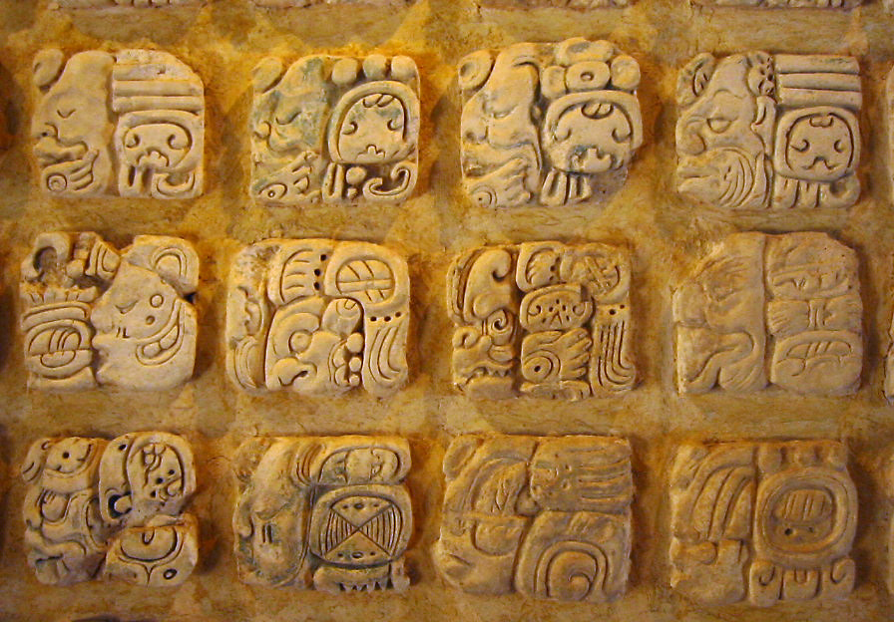
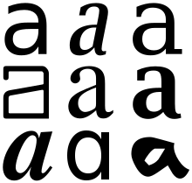
What is glyph?
A glyph is any kind of purposeful mark. In typography, a glyph is "the specific shape, design, or representation of a character. A grapheme, or part of a grapheme (such as a diacritic), or sometimes several graphemes in combination (a composed glyph) can be represented by a glyph. - Wikipedia
Various glyphs representing the lower case letter "a";
Mayan glyphs - https://en.wiktionary.org/wiki/glyph

Slide 13

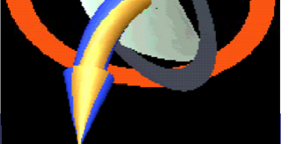
Tensors Glyph
In 3D, tensors are 3x3 matrices.
The velocity gradient tensor is nonsymmetric → 9 degrees of freedom for the local change of the velocity vector.
A glyph developed by de Leeuw and van Wijk can visualize all these 9 DOFs:
tangential acceleration (1): green "membrane"
orthogonal acceleration (2): curvature of arrow
twist (1): candy stripes
shear (2): orange ellipse (gray ellipse for ref.)
convergence/divergence (3): white "parabolic reflector"

Slide 14
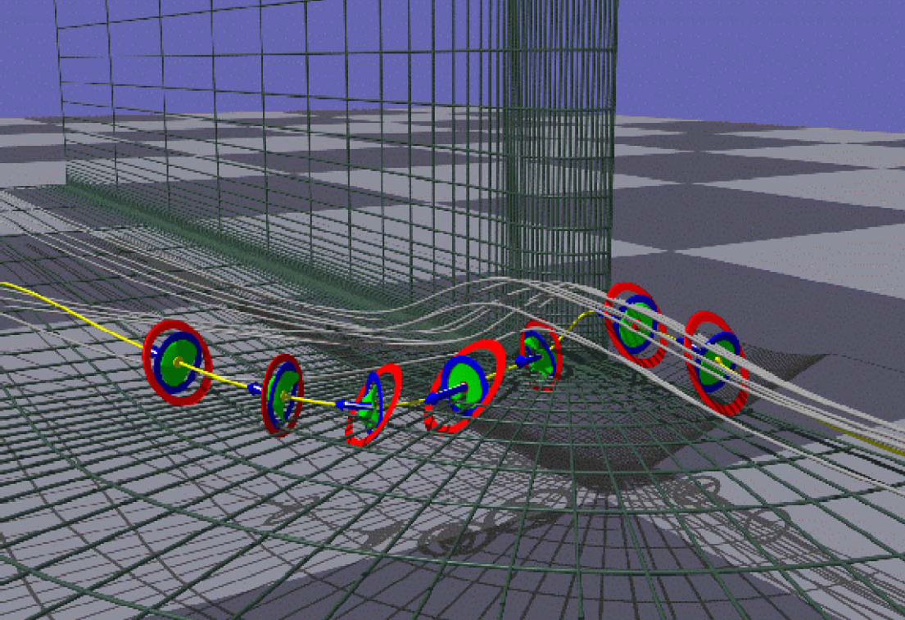
Tensor glyphs
Example:
NASA "bluntfin" dataset, glyphs shown on points on a streamline.

Slide 15

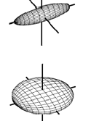
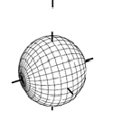
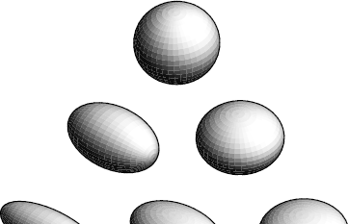
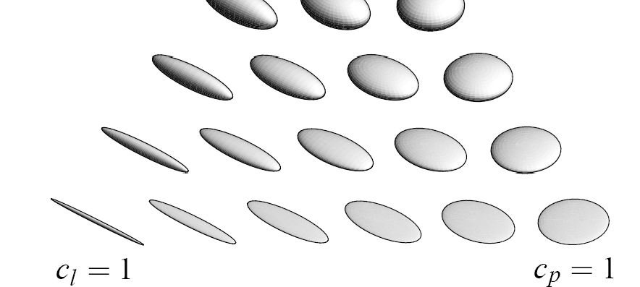
Tensor glyphs
Symmetric 3D tensors have real eigenvalues and orthogonal eigenvectors → they can be represented by ellipsoids.
Three types of anisotropy Anisotropy measure:
:
linear anisotropy
planar anisotropy
isotropy (spherical)
c_{l} = (λ₁ − λ₂ ) (λ₁ + λ₂ + λ₃ )
c_{p} = 2(λ₂ − λ₃ ) (λ₁ + λ₂ + λ₃ )
c_{s} = 3λ₃ (λ₁ + λ₂ + λ₃ )
(λ₁ ≥ λ₂ ≥ λ₃ )
Images: G. Kindlmann

Slide 16
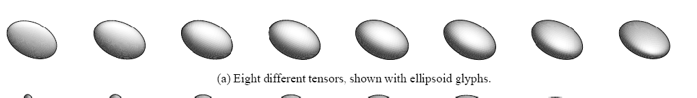
Problem of ellipsoid glyphs:
Tensor glyphs
shape is poorly recognized in projected view
Example: 8 ellipsoids, 2 views

Slide 17
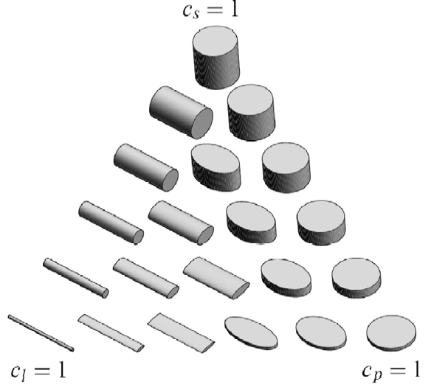
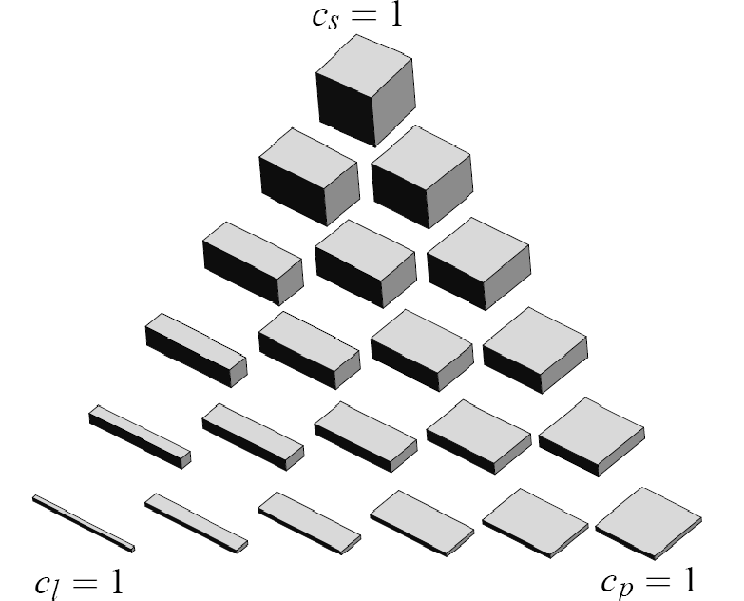
Problems of cylinder glyphs:
Problem of cuboid glyphs:
small differences in eigenvalues are over- emphasized
discontinuity at c_{l} = c_{p}
artificial orientation at c_{s} = 1

Slide 18
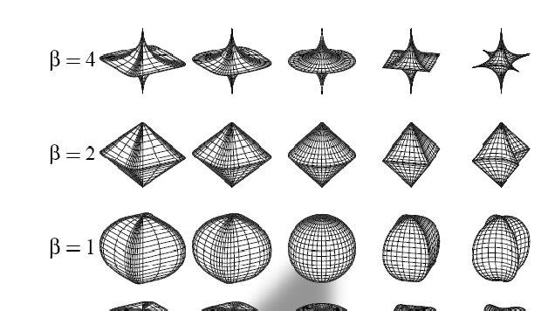
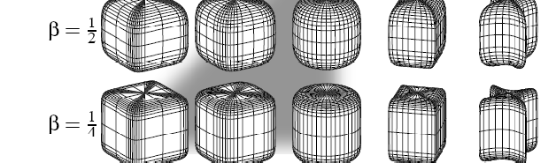
Tensor glyphs
Combining advantages: superquadrics Superquadrics with z as primary axis:
⎛ cos^{α} θ sin^{β} ϕ ⎞
( )
⎜
⎟
⎟
α β
q θ,ϕ = sin θ sin ϕ
z
⎜
⎜
cos^{β} ϕ
⎟
⎝
⎠
0 ≤ θ ≤ 2π , 0 ≤ ϕ ≤ π
with
cos^{α} θ
used as shorthand for
Superquadrics for some pairs (α,β)
Shaded: subrange used for glyphs
cosθ ^{α} sgn(cosθ )

Slide 19
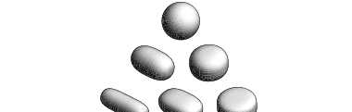

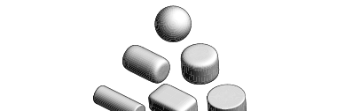
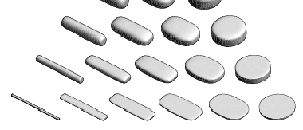
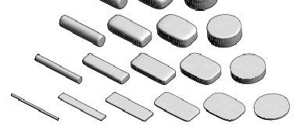
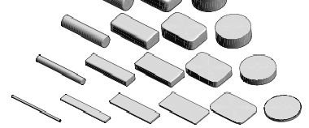
Tensor glyphs
Superquadric glyphs (Kindlmann): Given c_{l} , c_{p} , c_{s}
compute a base superquadric using a sharpness value γ:
( )
( ) ( )
⎧if c ≥ c
: q θ,ϕ
with α
with α
( )
γ
and β
and β
( )
γ
= 1− c
= 1− c
q (θ,ϕ ) = ⎪
l
p
z
p
l
⎨
⎪⎩if c_{l} < c
: q θ,ϕ
= 1− c
γ
( )
γ
= 1− c
p x
l
p
scale with c_{l} , c_{p} , c_{s} along x,y,z and rotate into eigenvector frame
c_{s} = 1 c_{s} = 1 c_{s} = 1
c_{l} = 1
c_{p} = 1
c_{l} = 1
c_{p} = 1
c_{l} = 1
c_{p} = 1
γ = 1.5
γ = 3.0
γ = 6.0

Slide 20
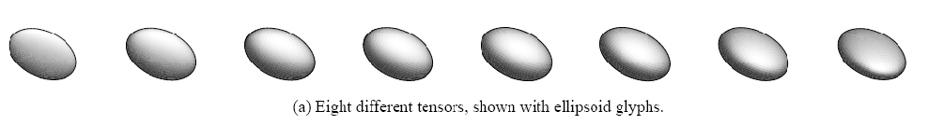
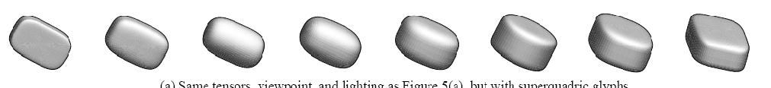
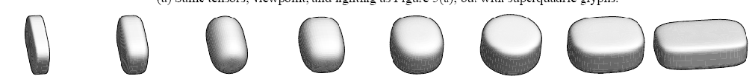
Comparison of shape perception (previous example)
with ellipsoid glyphs
with superquadrics glyphs

Slide 21
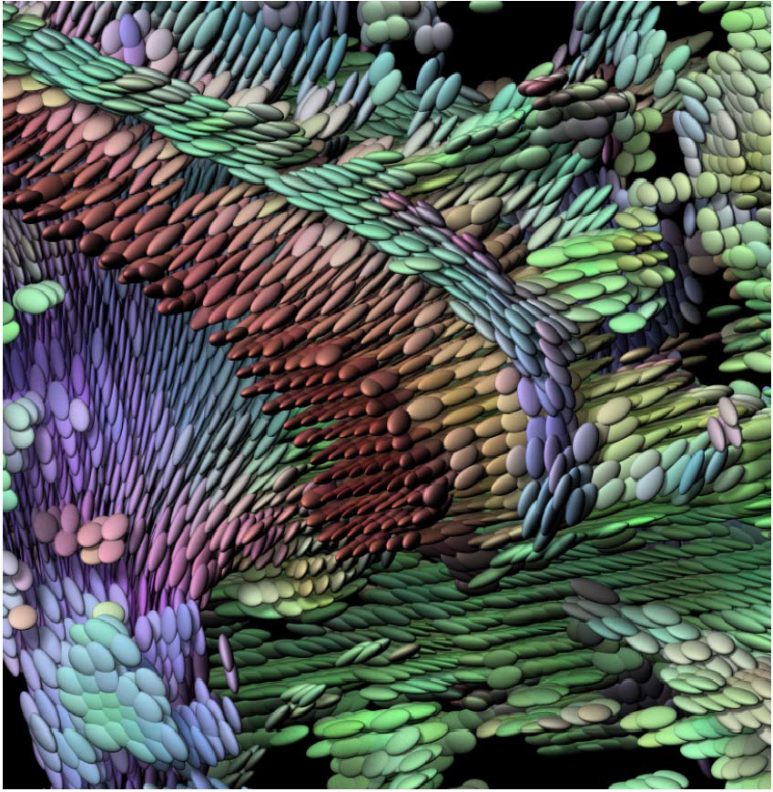
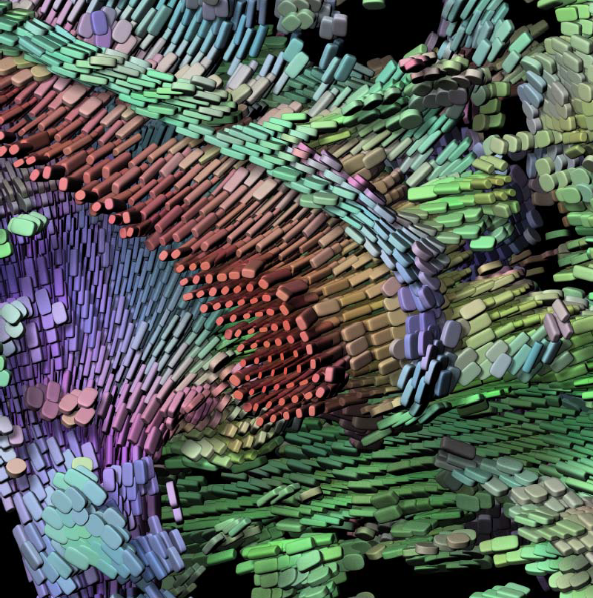
Comparison: Ellipsoids vs. superquadrics (Kindlmann)
⎛ e¹ ⎞
⎛ R ⎞
⎜
x ⎟
⎛1⎞
color map:
⎜G ⎟ = c ⎜ e^{1 ⎟} + 1− c
⎜₁⎟
(with e¹ = major eigenvector)
⎜ ⎟
l ⎜ y
⎟
l
⎜ ⎟
⎜ _{B} ⎟
⎜
1 ⎟
⎜₁⎟
⎝ ⎠
⎝ ^{ez} ⎠
⎝ ⎠

Slide 22
Tensor field lines

Slide 23
Tensor field lines
Let T(x) be a (2nd order) symmetric tensor field.
→ real eigenvalues, orthogonal eigenvectors
Tensor field line: by integrating along one of the eigenvectors Important: Eigenvector fields are not vector fields!
eigenvectors have no magnitude and no orientation (are bidirectional)
the choice of the eigenvector can be made consistently as long as eigenvalues are all different
tensor field lines can intersect only at points where two or more eigenvalues are equal, so-called degenerate points.

Slide 24
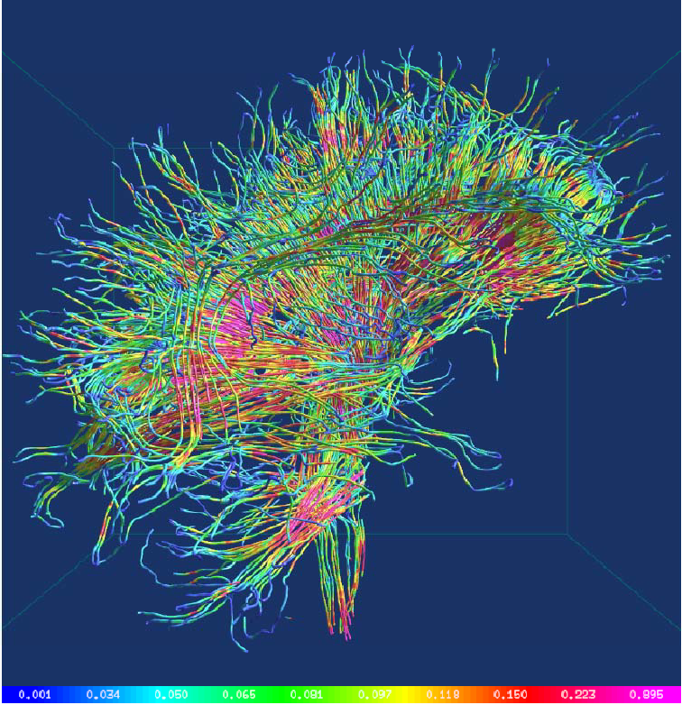
Tensor field lines can be rendered as hyperstreamlines:
tubes with elliptic cross section, radii proportional to 2nd and 3rd eigenvalue.
Image credit: W. Shen

Slide 25
Tensor field topology
Based on tensor field lines, a tensor field topology can be defined, in analogy to vector field topology.
Degenerate points play the role of critical points:
At degenerate points, infinitely many directions (of eigenvectors) exist.
For simplicity, we only study the 2D case.
For locating degenerate points: solve equations
T₁₁ (x ) − T₂₂ (x ) = 0, T₁₂ (x ) = 0

Slide 26
Tensor field topology
It can be shown:
The type of the degenerated point depends on
δ = ad − bc
_{a =} 1 ∂ (T₁₁ − T₂₂ ) _{b =} 1 ∂ (T₁₁ − T₂₂ )
where
2 ∂x 2 ∂y _{c =} ∂T_{12 d =} ∂T₁₂
∂x ∂y
for δ<0 the type is a trisector
for δ>0 the type is a wedge
for δ=0 the type is structurally unstable

Slide 27
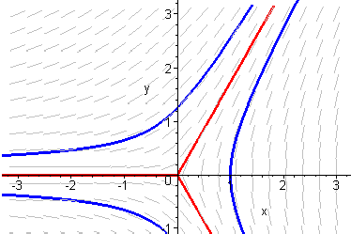
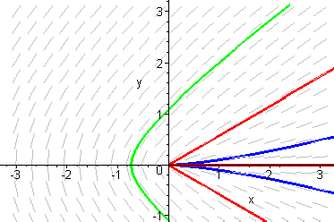
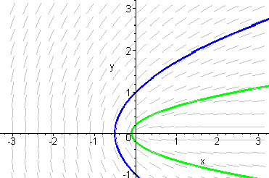
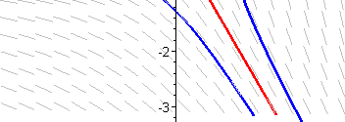
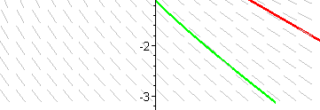
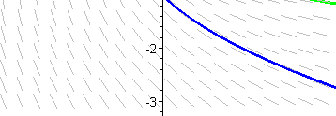
Types of degenerate points, illustrated with linear tensor fields.
Tensor field topoloy
trisector
double wedge
single wedge
_{T =} ⎛1− 2x y ⎞
_{T =} ⎛1+ 2x 3 y ⎞
_{T =} ⎛1+ x y
⎞
⎜ ₁ ⎟
⎜ ₁ ⎟
⎜
y
y
⎝
⎛
y 1− x ⎟
⎝ ⎠
⎝ ⎠
⎠
⎛
e =
_{x}2
+ y ² − x ⎞
⎛ x + x² + 9y ^{2 ⎞}
e =
y
⎞
⎜
⎟
⎜
⎟
e = ⎜
_{x}2
⎟
⎜
y
⎟
3y
⎜
+ y ² − x ⎟
⎝
⎠
⎝ ⎠
⎝
⎠
δ = −1
δ = 13
δ = 1

Slide 28
Higher Order Tensors

Slide 29
Driving Problem
How to visualize fourth-order tensor fields representing a solid’s time-varying stiffness (such as soil during an earthquake).
Two Stages:
Meaningful decomposition to reduce number of components per field location: 3x3x3x3 6x6 3x3 1
Meaningful visualization to find locations of softening and mode of stress to which the material is vulnerable.

Slide 30
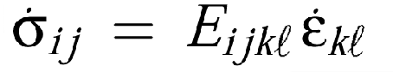
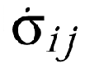
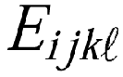
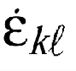
Basic Constitutive Equation
Hooke’s Law generalized to 3D (what gets solved by the simulator)
: stress increment
: 4th-order elastic-plastic tangent stiffness
: strain increment
i, j, k, l range from 1 to 3, and represent orthogonal spatial axes x, y, z

Slide 31
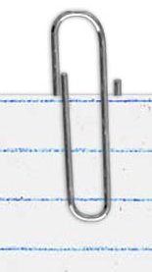
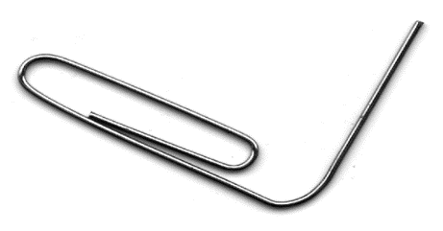
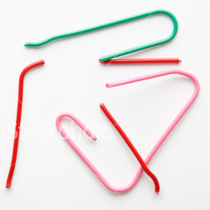
Solid Mechanics Vocabulary
Elastic: recoverable deformation
Elastic-Plastic: recoverable + permanent deformation
Localized failure

Slide 32
Stiffness Changes With Increasing Stress
Material Behavior | E_{ijkl} Properties
Elastic | Positive-definite, fully symmetric
Elastic-plastic | Eigenvalues get smaller, non-singular, may lose major symmetry
Failure, localized | Non-positive-definite, possibly singular
Non-trivial to decompose (or visualize!)

Slide 33
Approach
Unroll the 3x3x3x3 tensor into a 6x6 matrix.
Numerical methods only exist for matrices
Polar decomposition on the matrix produces
two 6 x 6 matrices; the rotation part and the symmetric stretch part.
Eigen-decomposition on the stretch yielding
6 (6-element) eigenvectors and 6 real eigenvalues.
Select a single eigenvector and compose it into a symmetric 3 x 3 tensor.
Visualize the second-order eigentensor with a glyph that shows its structure and also reflects its eigenvalue.

Slide 34
Application Constraints
Small Deformation Theory
Small displacement gradients
Stiffness cast with respect to reference configuration; changes associated with rigid material rotation eliminated from consideration
Second-order tensors must be symmetric
Constrains fourth-order tensors to exhibit minor symmetry, i.e. E_{ijkl} = E_{jikl} = E_{jilk} = E_{ijlk}
Natural materials exhibit minor symmetry

Slide 35
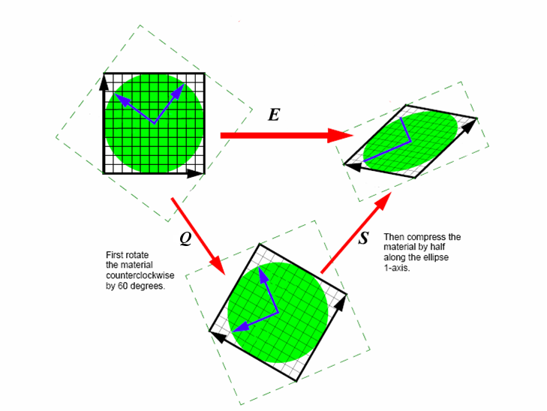
Polar Decomposition
Uniquely separates a matrix into two components:
where Q is a pure rotation matrix (orthonormal, positive determinant) and S is a stretch (symmetric, positive-semi-definite).
E = QS

Slide 36
Polar Stretch and Mode of Vulnerability
Eigen-decomposition applied to stretch S yields 6 second-order eigentensors and eigenvalues.
A reduced eigenvalue means the solid is less stiff* and the associated eigentensor is the mode of stress for which the solid has the most reduction in stiffness.
* terminology may vary

Slide 37
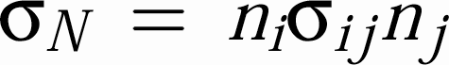
Eigentensor Glyphs
Eigentensor glyphs drawn by stretching a unit sphere according to the formula
n
where n is a unit length direction vector from the center of the sphere to a point on the surface

Slide 38
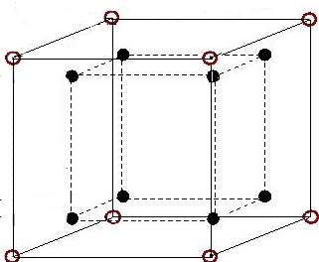
Glyphs and Finite Elements
node
Gauss point
As the solid deforms, stress changes induced at Gauss integration points
Irregular layout on X, Y, and Z
1-2 orders of magnitude difference in element sizes
Glyph scale factor: distance between Gauss points in single element
y
x
z
Finite Element (8 node brick)

Slide 39
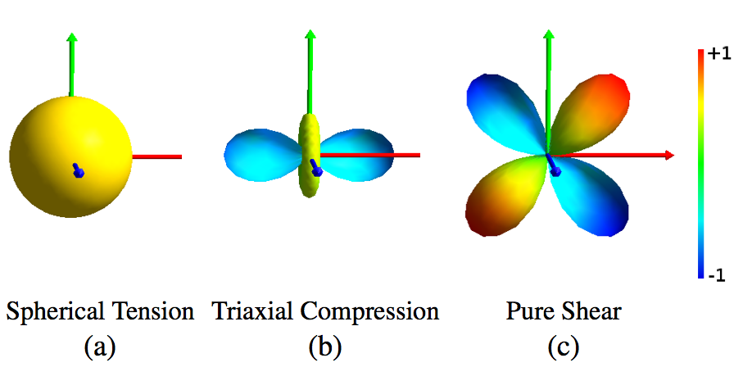
Physical Meaning
Stress Modes
Two equal eigenvalues + distinct eigenvalue more compressive than the others
One zero eigenvalue, with 2 others equal but opposite in sign
Isotropic, 3 equal eigenvalues

Slide 40
Experiments
Stage 1:
Soil self-weight compression (–Z), 25 steps
Induces deformation and may change stiffness
Stage 2:
Two point loads, 100 steps
Small –Z component (0.9659 kN) and
Large +X component (1294 kN)

Slide 41
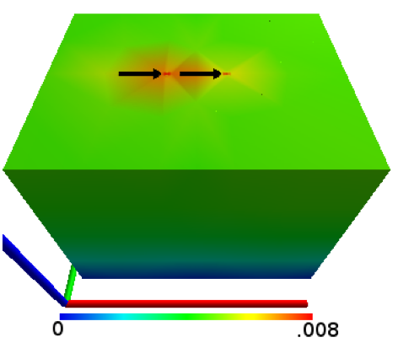
Deformation From Experiments
Black arrows indicate point load locations
Variation due to self weight

Slide 42
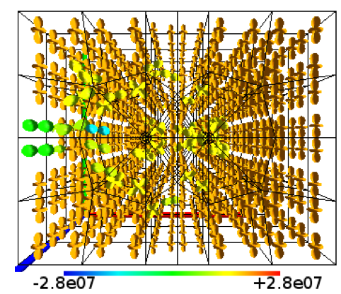
Material 1: Drucker-Prager Soil Model
Fails under tension
Non-hardening (no change with compression)
Stage 1: No change
Stage 2: Experienced compression in front of point loads and tension behind

Slide 43
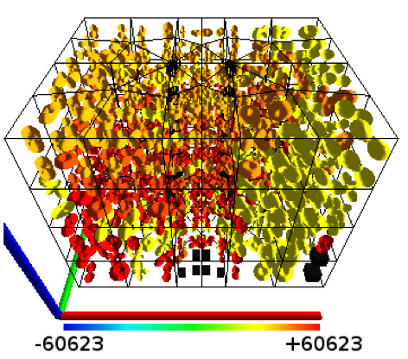
Material 2: Dafalias-Manzari Soil Model
Pressure-dependent
Non-associated flow
Stage 1: induced hardening
Stage 2: softening and singularity
Difficult to correlate stress to soil’s behavior

